Slide 1
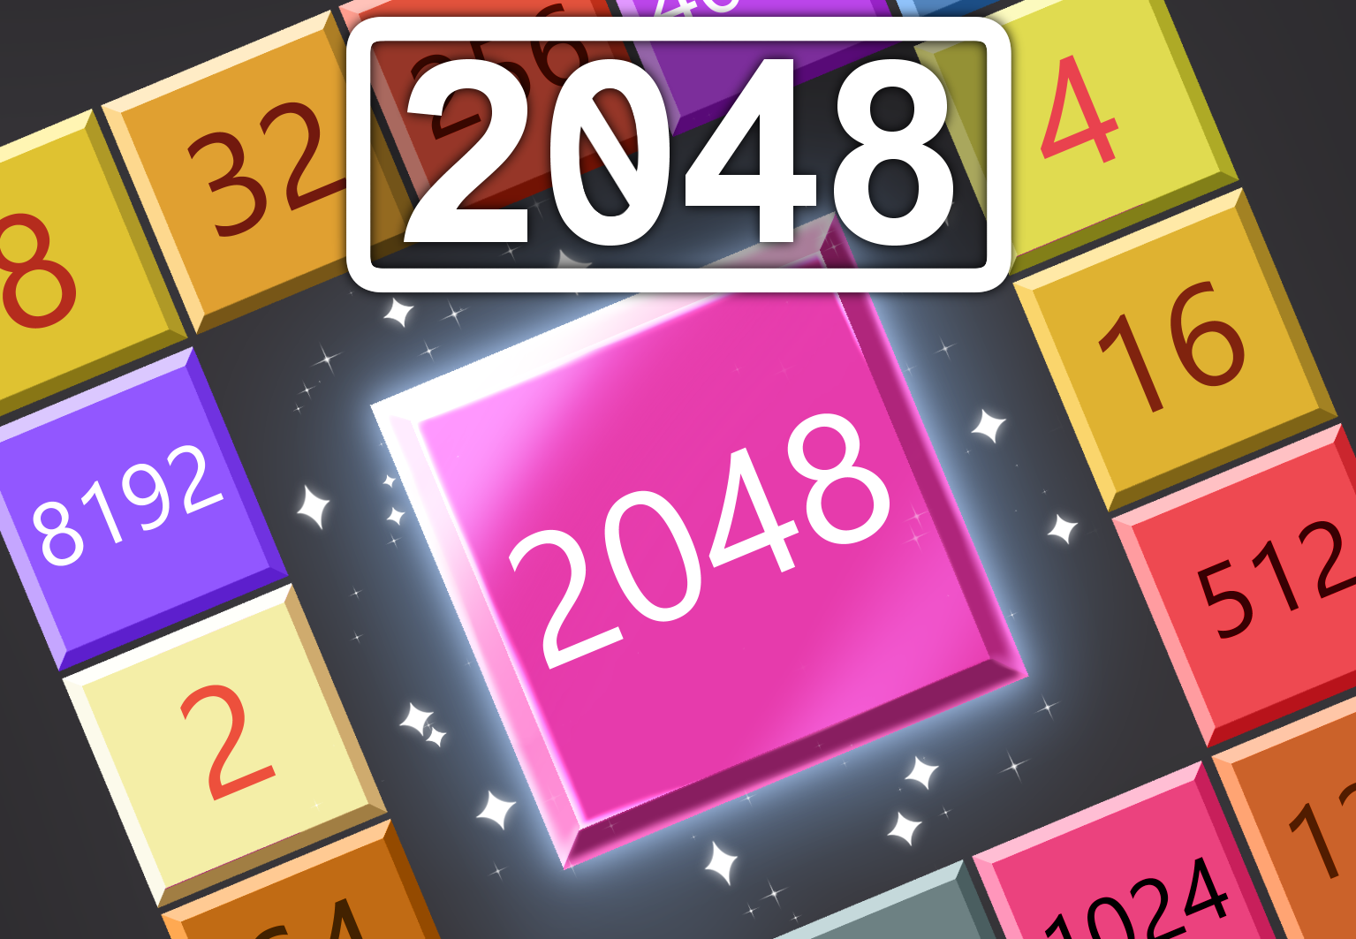

2048
INSTRUCTION MANUAL
32-BIT VIRTUAL CONSOLE

Slide 3

Please read this instruction manual carefully before using your Vircon32 console or your game cartridge. Then keep this manual for any future consultations you may have about playing this game.
This seal guarantees that the Vircon32 community has tested this product and that it fulfills the needed requirements to ensure a reliable gaming experience.
Always look for this seal on your products to ensure a complete compatibility with your Vircon32 console and accessories.
EPILEPSY WARNING
READ BEFORE USING YOUR VIRCON32 GAME
A very small proportion of the population may experience epileptic seizures when viewing certain patterns of flashing lights that are common in our everyday environments. These people may experience seizures while watching some video images or playing certain videogames.
Players who have never had seizures previously might still have an as of yet undetected epilectic condition. Consult your physician before playing videogames if you have an epilectic condition, or if you experience any ot these symptoms while playing videogames: altered vision, muscle twitching, involuntary movements, loss of awareness, mental confusion and/or convulsions.
1

Slide 4

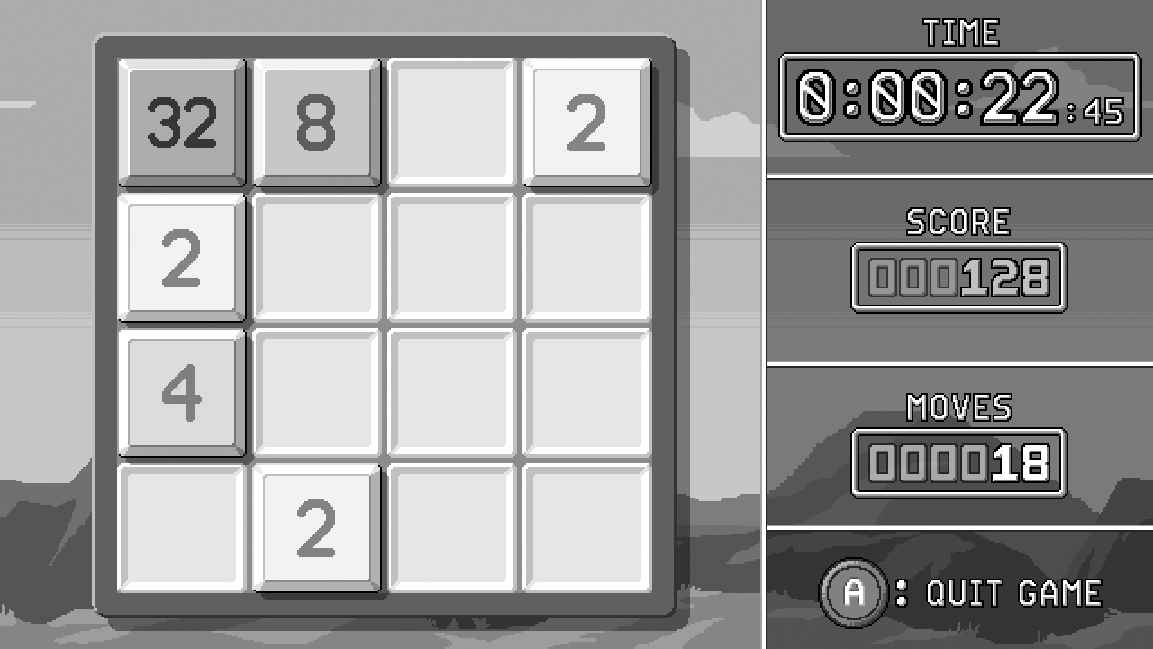
Welcome to 2048, the number tile puzzle! This version is an adaptation from the original 2048 game by Gabrielle Cirulli. This manual will teach you everything you need to know to play thegame.
The game screen
Here are the basic game elements you will see when playing:
Game board
Game statistics
Number tiles
Free tiles
2

Slide 5
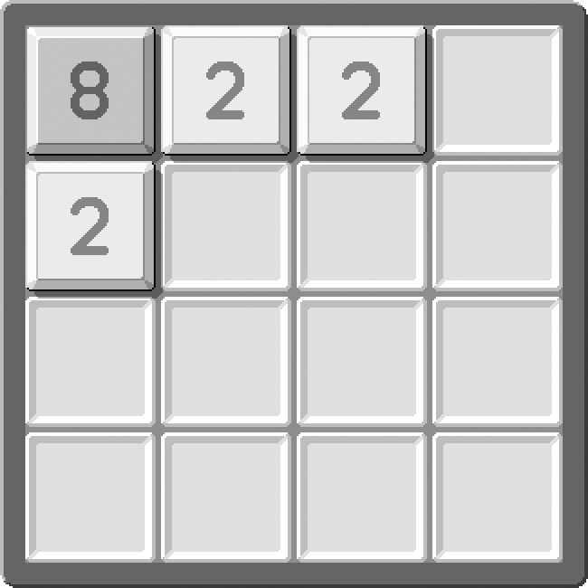
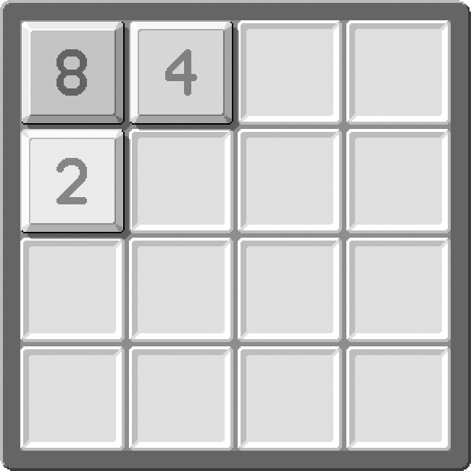
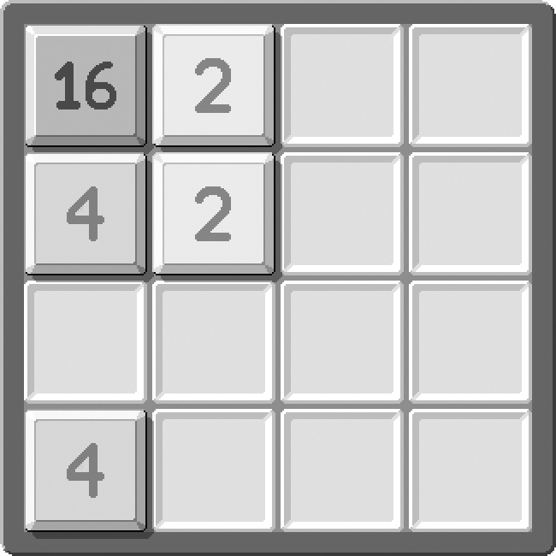
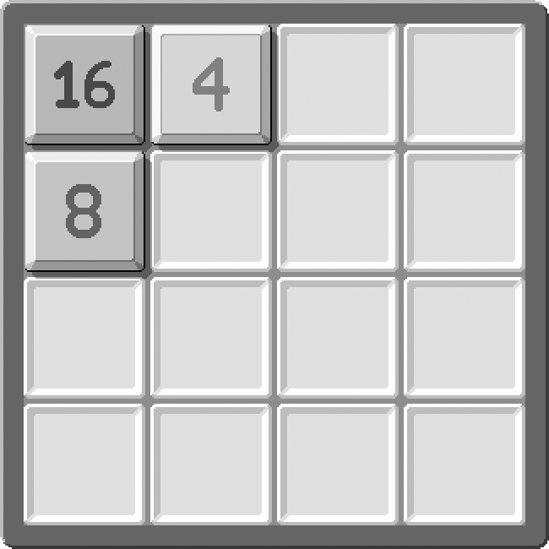
How to play the game
2048 is played in a 4 x 4 board, in which number tiles are placed. Each turn the player must move the board in one of the 4 directions (up, down, left or right). This makes all number tiles slide in that direction. If 2 tiles with the same number collide, they will combine into a single tile with double the number. For instance: [2] + [2] → [4].
Here are some examples of moves that make tiles combine:
after moving left
after moving up
The objective of the game is to keep combining tiles to reach greater numbers, until a 2048 tile is formed.
After each move a new tile will be added to the board, so you need to keep combining tiles to make room. If at some point the board becomes full and you can’t combine tiles with any possible move, you will lose the game.
3

Slide 6
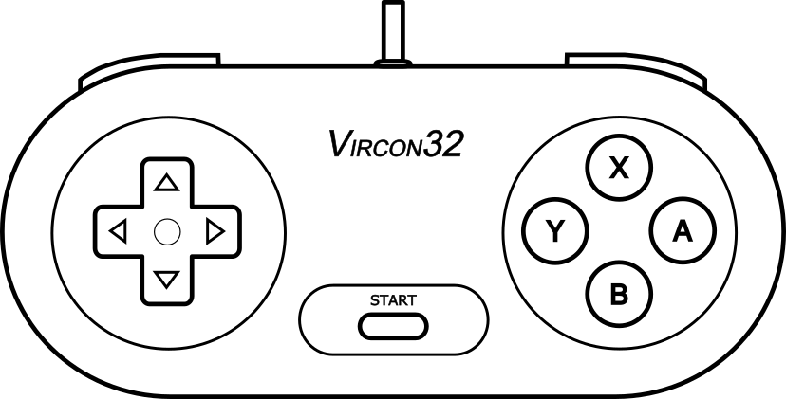
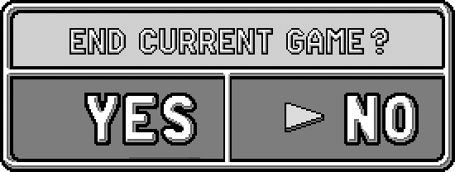
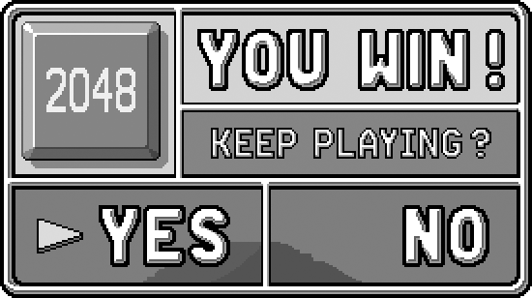
Game controls
2048 is a single player game and it only uses gamepad number 1. The controls for gameplay are the following:
Move board
(all 4 directions)
Quit game
dialog
Choosing options in dialogs
There are situations when the game will show a dialog on screen. Simple dialogs only display a message, but others will ask you to make a choice about your current game:
If you press button A you will open the quit dialog. You can use it as a temporary pause and resume, or actually quit.
If you reach 2048 and win the game, you will actually have the option to go on and keep playing! You can stay in the game and try to reach the highest tile you can.
4

Slide 8

@ 2022 CARRA
PRINTED IN MADRID, SPAIN
THIS INSTRUCTION MANUAL IS PART OF THE GAME ‘2048’
AND SHOULD BE DISTRIBUTED ALONG WITH THE GAME PACKAGE.

